Slide 1


Balance Webinar #1 2025
Product Updates
2/12/25

Slide 2
Fund Reporting Role

Slide 3

Fund Reporting Role
Role Based Access for Administering Funds
Stay Compliant with Dashboard visibility by # funds and $ funds
View Fund Activity by Endowment and Expendable detail
Track Actual Spending to Date
Fund health and terms to be met
Donor Purpose
Documents
NEW for all customers with Pro/Premium pricing; “Department Module”

Slide 4
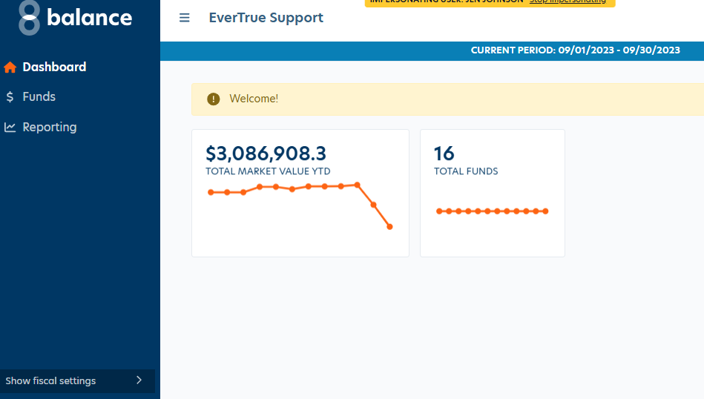
Dashboard (Q1 2025)
Easily identify what Time Period fund information is available as of
Review internal notifications set by Balance Administrator
Easily Communicate Total $ Value of Funds Managing and fund health
Transparency into Total # Funds Managing (including both Endowment and Expendable Funds)
Coming Soon: Ability to access internal guidelines, procedures; # Funds not yet seasoned (with drill down into terms)

Slide 5
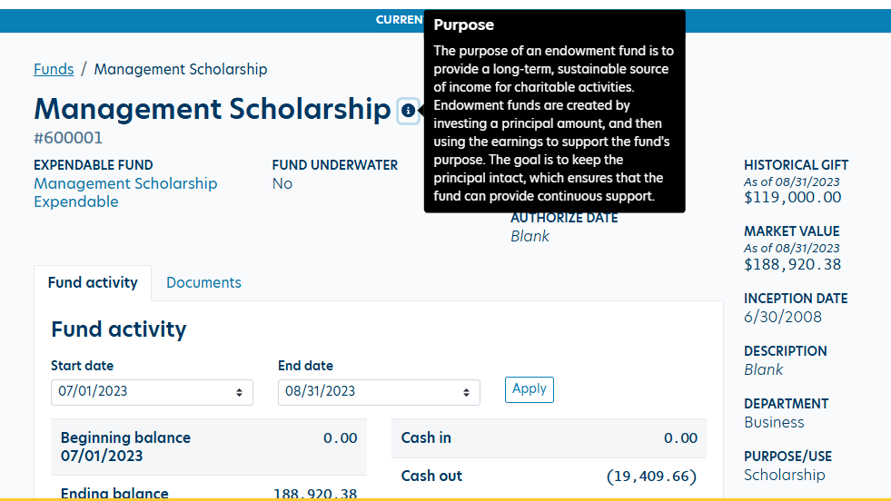
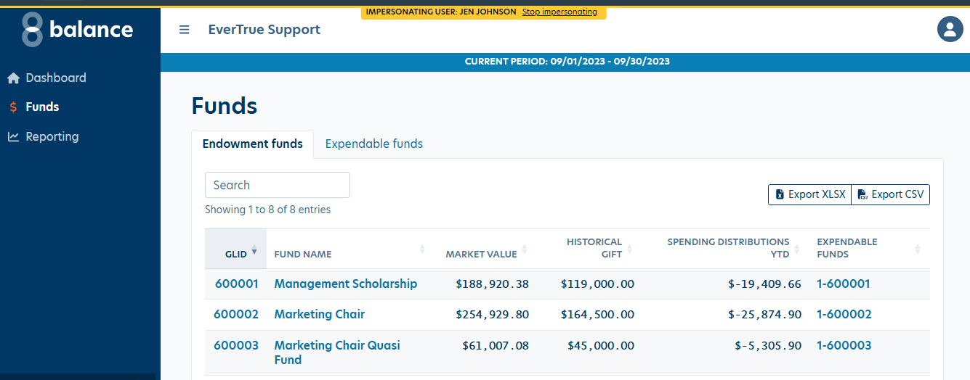
Endowment Funds
Easily view and access the specific funds responsible for administering
How is the overall health of the funds? Export the data for analysis
What is the spending payout distribution year to date?
Easily drill into an endowment fund and any corresponding expendable fund for detail

Slide 6
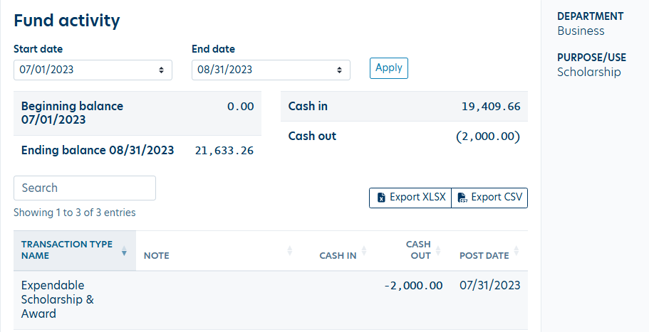
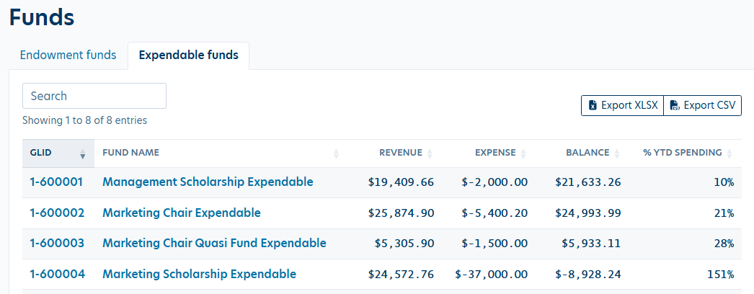
Expendable Funds
Easily view and access the specific funds responsible for administering
What are available balances year to date?
What spending activity has occurred vs. gifts vs. endowment payout revenue?
Click into detail, click to endowment fund, see purpose with activity detail.

Slide 7
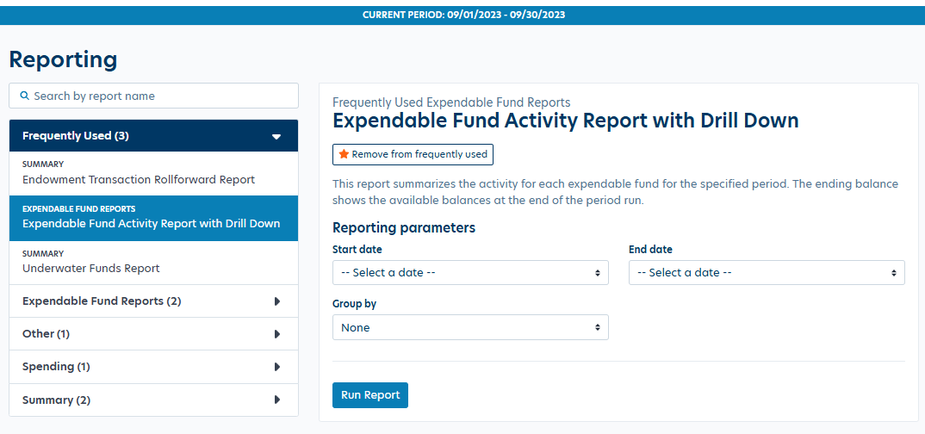
Reporting
Find Specific Reports Turned on by your Organization’s Administrator
Reporting restricted by user access to funds

Slide 8
What is the setup for new role?
Contact Support to Turn On this Role
Role is available as an option when creating and editing a user
Administrator is able to
  Impersonate Fund Reporting Role User
  Enable Reports Available to Role, Set Dates available for fund data
  Manage Home Page notifications
  Setup contact information for users to reach out with questions

Slide 9
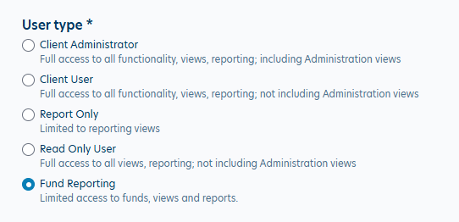
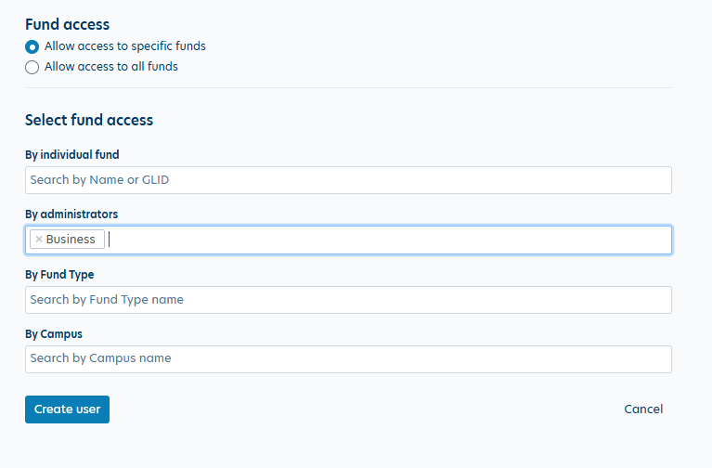
User Role Setup

Slide 10
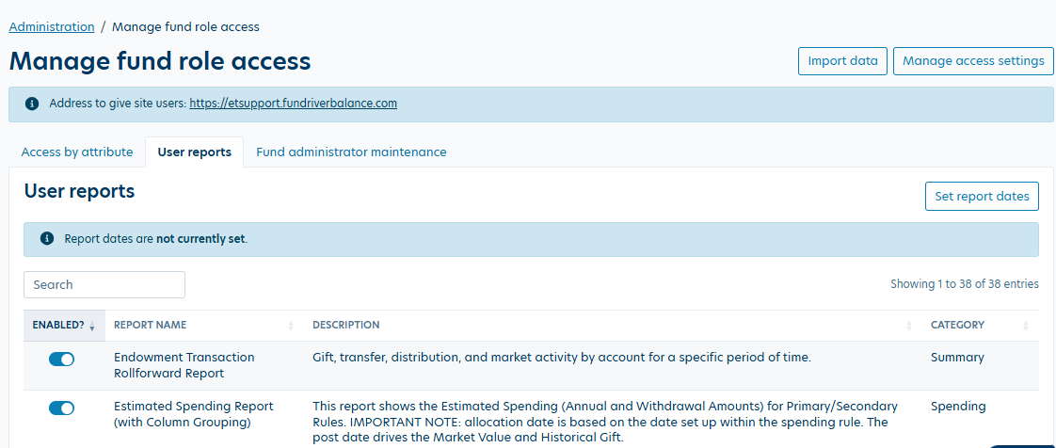
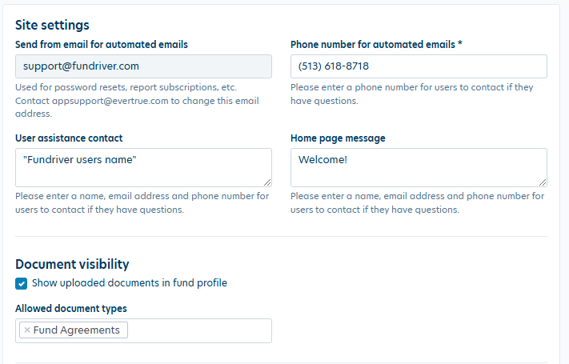
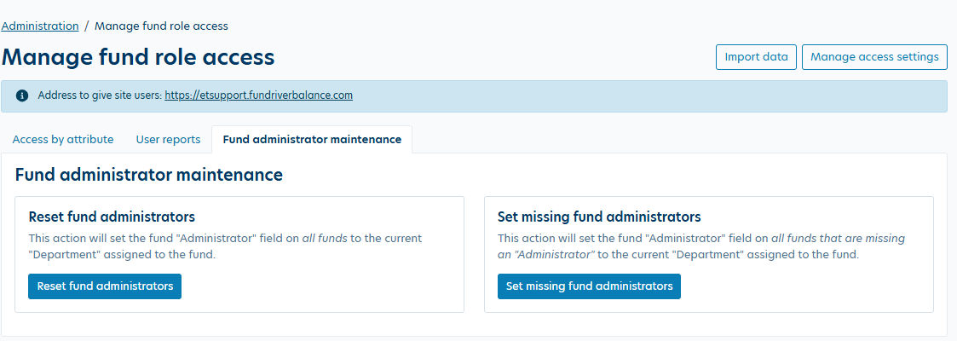
Additional Role Settings

