Slide 1
Balance Expendable Funds
June 26, 2024

Slide 2

Why track Expendable Funds in Balance?
Easy Setup
Simple import file for uploading funds, balances and transactional activity based your organizational needs. Create custom transaction types to suit your reporting needs.
Manage the utilization of expendable funds
Dashboards and Views that will show how well your organization is utilizing donor funds. Run activity reports, produce automated budget reports. Use with the Department Module and Fundriver Impact to provide a full picture to your constituents, internally and externally.
Easily Manage Endowment and Expendable funds
Link an expendable fund to an endowed fund for full spending transparency (and an automated transfer of distributions). User interface that shows all expendable funds and their endowment funds.
Identify when Funds are available to spend
View that returns feedback on whether funds have met spending

Slide 3
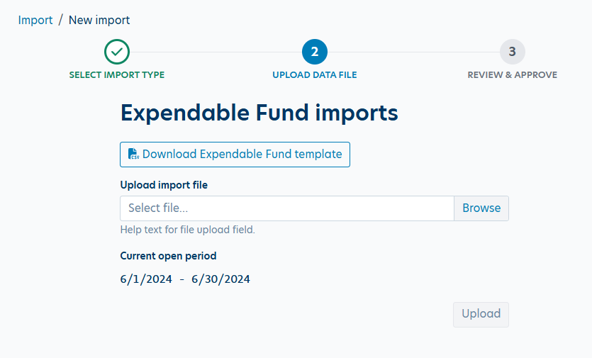
Easy Setup

Slide 4
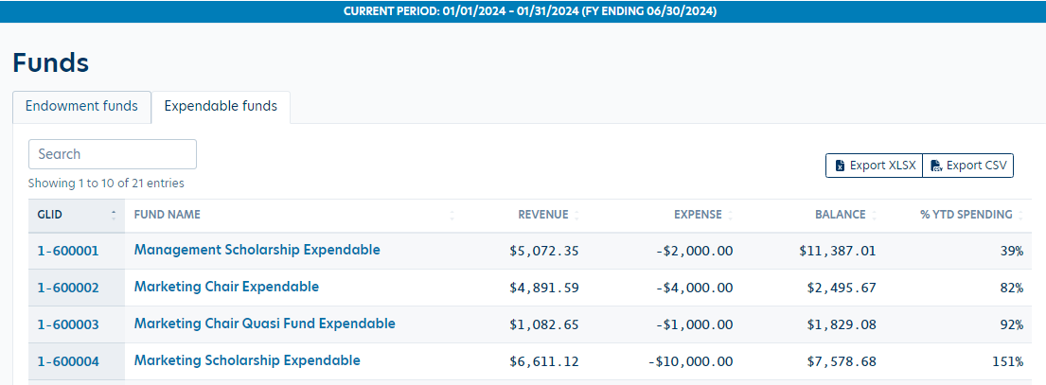
Utilization of expendable funds

Slide 5
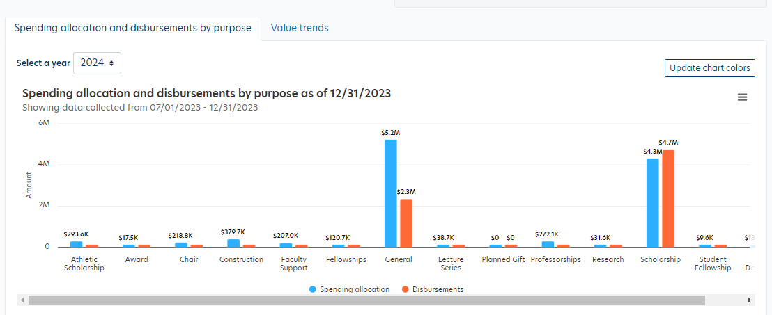
Utilization of expendable funds

Slide 6
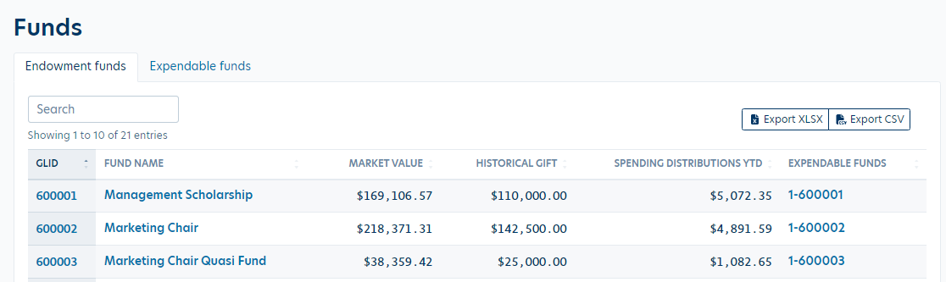
Manage Endowment & Expendable Funds

Slide 7
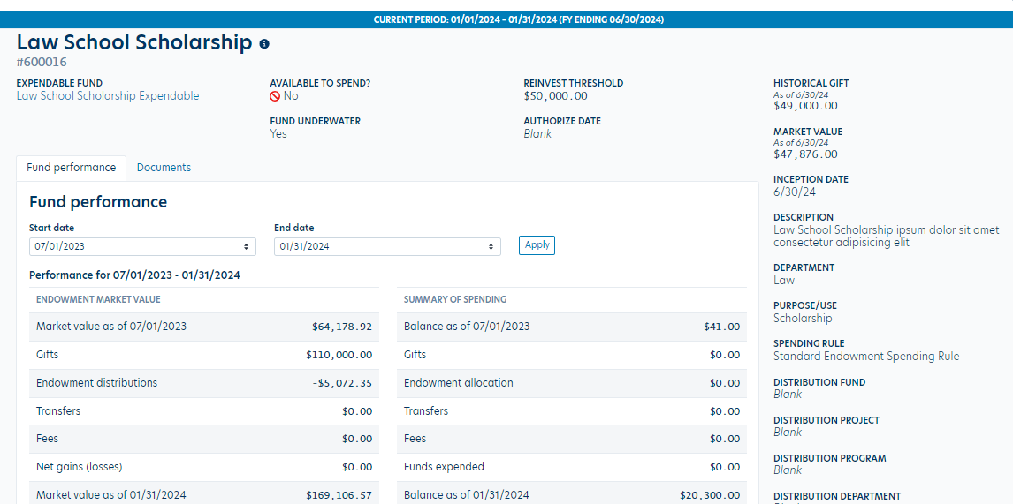
Manage Endowment & Expendable Funds

Slide 8
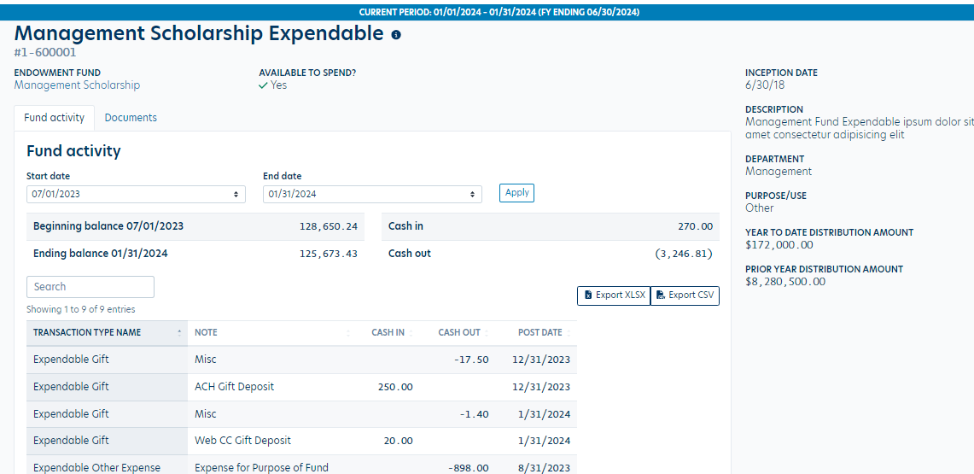
Manage Endowment & Expendable Funds

Slide 9
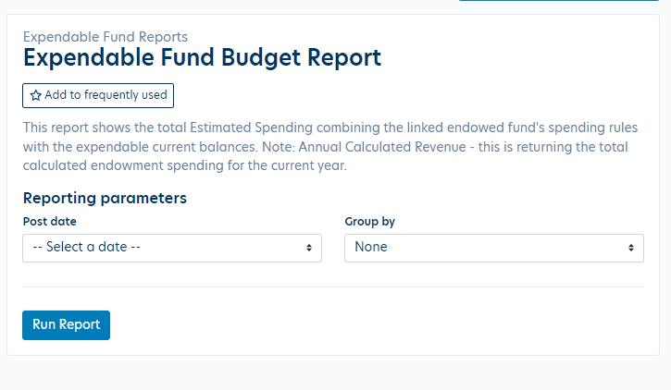
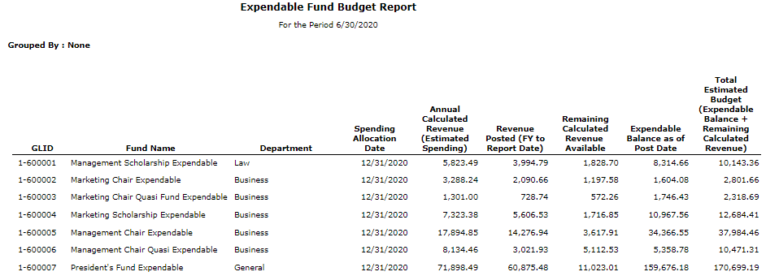
Additional Reporting

Slide 10
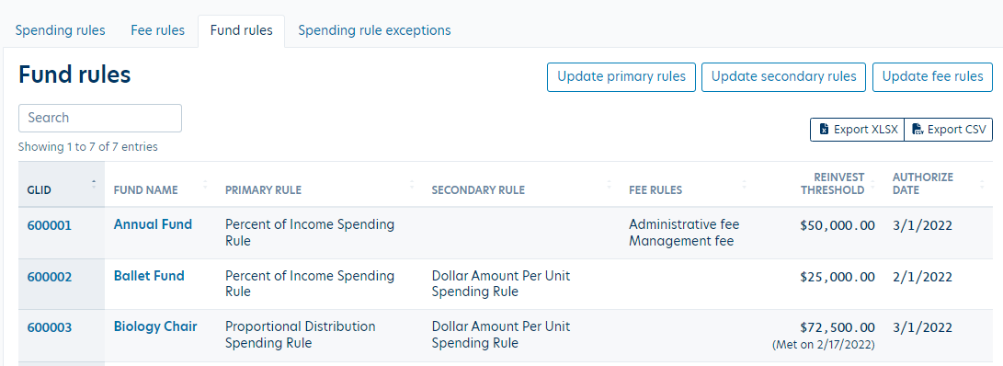
Identify when Funds are available to spend

